Slide 1
Spline Interpolation
By
Dr. Sikander M. Mirza
Department of Physics & Applied Mathematics
Pakistan Institute of Engineering and Applied Sciences
Nilore, Islamabad 45650, Pakistan

Slide 2
Introduction
Spline interpolation uses piecewise polynomial functions called splines to create a smooth curve that passes through a given set of data points.
Unlike a single high-degree polynomial, splines use lower-degree polynomials between segments, ensuring local fitting and preventing overfitting.
The segments connect at points called knots, and conditions on the continuity of the function and its derivatives (especially for higher-order splines like cubic splines) ensure a smooth, continuous, and accurate interpolation of the data's trend.

Slide 3
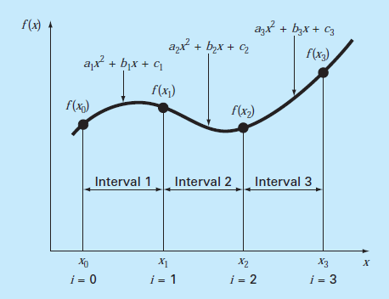
Introduction
For each segment, we have a spline
Each spline must pass through data points.
Two adjacent splines must be continuous at the common node.
Set second derivative zero at the first node, if needed.

Slide 4
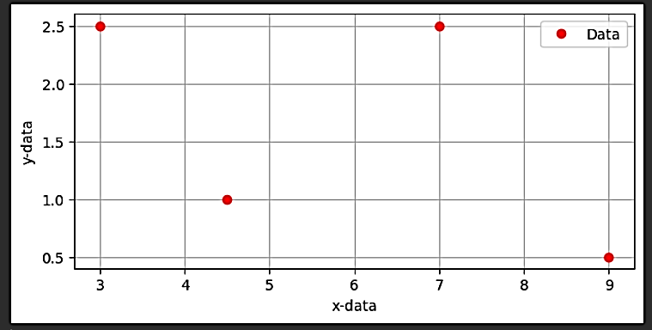
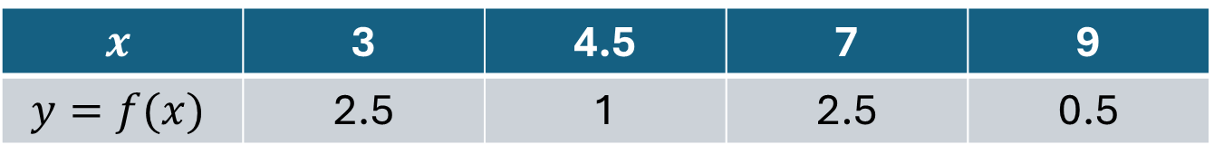
Example – 1
$$x$$ | 3 | 4.5 | 7 | 9
$$y=f(x)$$ | 2.5 | 1 | 2.5 | 0.5

Slide 5
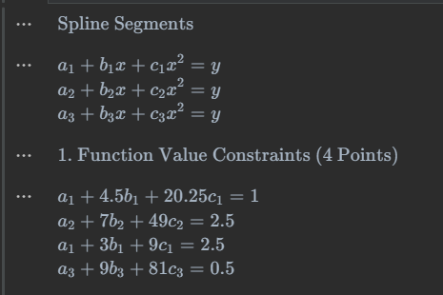
Example – 1
$$x$$ | 3 | 4.5 | 7 | 9
$$y=f(x)$$ | 2.5 | 1 | 2.5 | 0.5
Total 9 Unknows
4 - equations

Slide 6
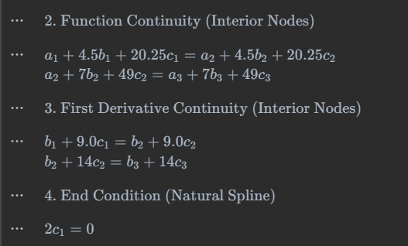
Example – 1
$$x$$ | 3 | 4.5 | 7 | 9
$$y=f(x)$$ | 2.5 | 1 | 2.5 | 0.5
2 – equations
Total So Far : 6
2 – equations
Total So Far : 8
1 – equation
Total So Far : 9

Slide 7
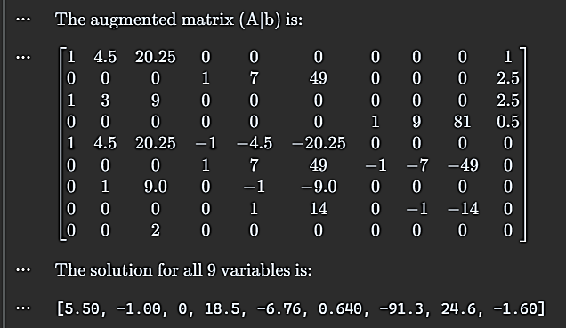
Example – 1
$$x$$ | 3 | 4.5 | 7 | 9
$$y=f(x)$$ | 2.5 | 1 | 2.5 | 0.5
9x9 Linear System
Solution of Ax=b System

Slide 8
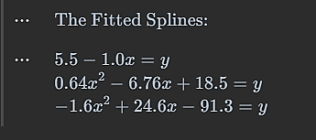
Example – 1
$$x$$ | 3 | 4.5 | 7 | 9
$$y=f(x)$$ | 2.5 | 1 | 2.5 | 0.5

Slide 9
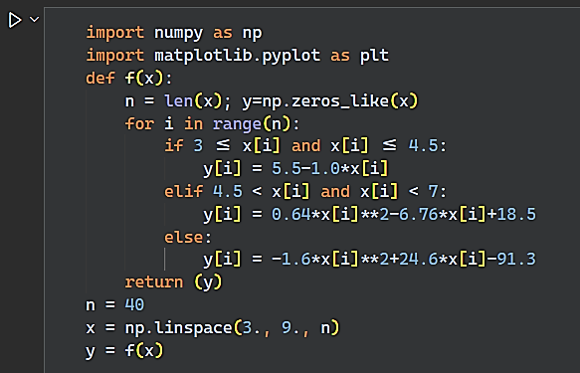
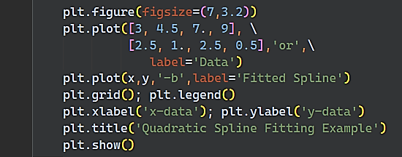
Example – 1

Slide 10
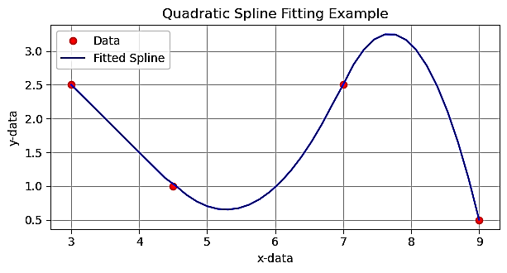
Example – 1

Slide 11
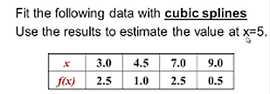
Introduction

Slide 12
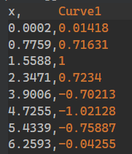
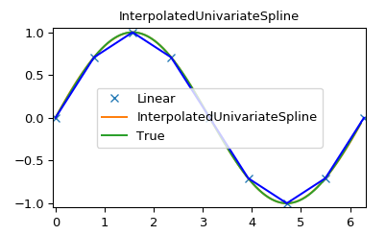
Exercise: Do Spline Fitting

Slide 13
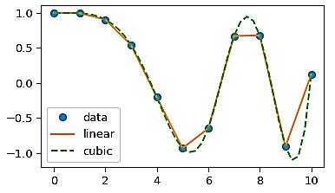
Digitize it and Fit Spline

